Slide 1
R & Power BI Assignment
By Lucy Coldridge
23/03/2023

Slide 2
Aim & The Data
Aim: To analyse the performance of Hollywood movies.
Data: Title, genre, studio, profitability and ratings for movies released 2007-2012.

Slide 3
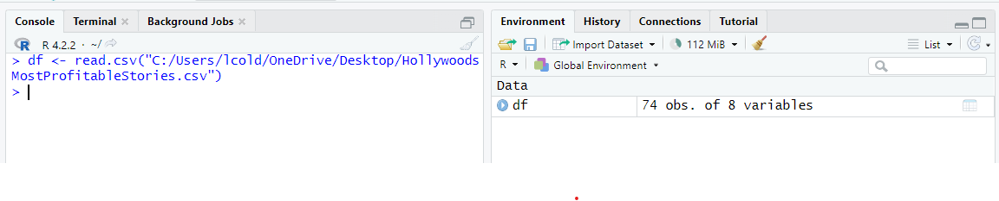

Step 1: Initial Exploratory Analysis
Firstly, I opened a new file in RStudio.
I then typed the path to where I saved my CSV file on my computer, which then loaded the data frame successfully.
Loading the data

Slide 4
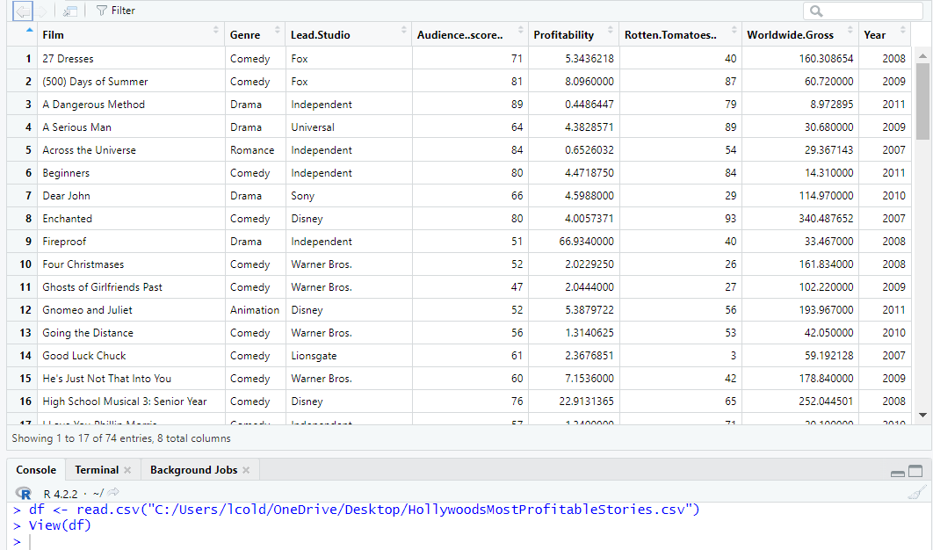

Step 1: Initial Exploratory Analysis
Viewing the data
To see what I was working with, I used ‘View(df)’ to clearly see my loaded data in a table format.

Slide 5
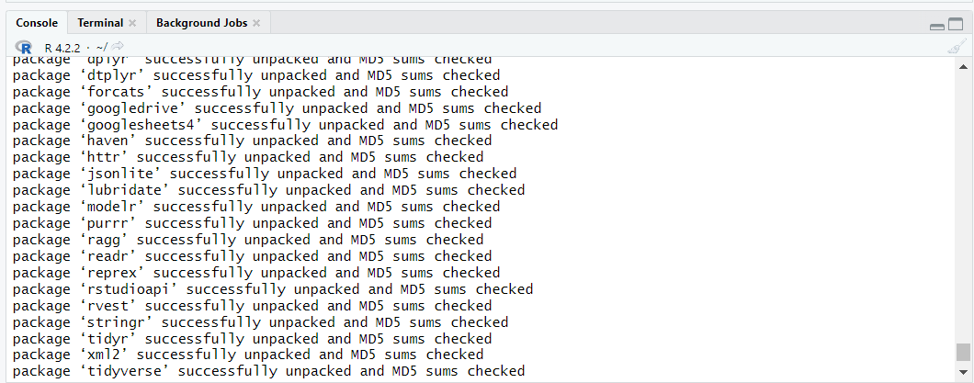
Step 1: Initial Exploratory Analysis
Loading and importing library
The next step was to load the library, which I did by installing the ‘tidyverse’ package.

Slide 6
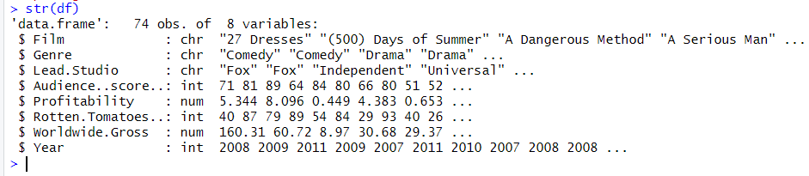
Step 1: Initial Exploratory Analysis
I called ‘str(df)’ to see the different data types in the data frame. It showed:
Character (chr)
Integer (int)
Numeric (num)
Checking the data types

Slide 7
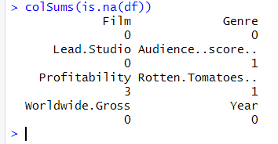
Step 2: Cleaning The Data
I called ‘colSums(is.na(df))’ to show any missing values in my data. The results showed there were 5 missing values:
x3 Profitability
x1 Audience score
x1 Rotten Tomatoes
Checking for missing values

Slide 8
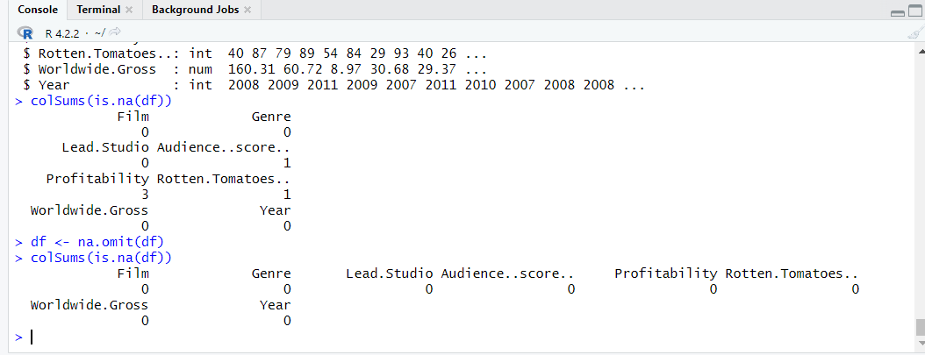
Step 2: Cleaning The Data
Dropping missing values
I used ‘df <- na.omit(df’ to drop the missing values and then checked to make sure they had been removed successfully.

Slide 9
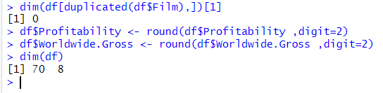
Step 2: Cleaning The Data
Using the code shown above, I checked for any duplicates, to which it displayed 0.
I then rounded the values of ‘profitability’ and ‘worldwide gross’, by 2 digits.
This makes the values shorter, simpler and better for visual representations later on.
Using dim(df) showed me there were 70 observations (rows) and 8 variables (columns).
Duplicates and rounding

Slide 10
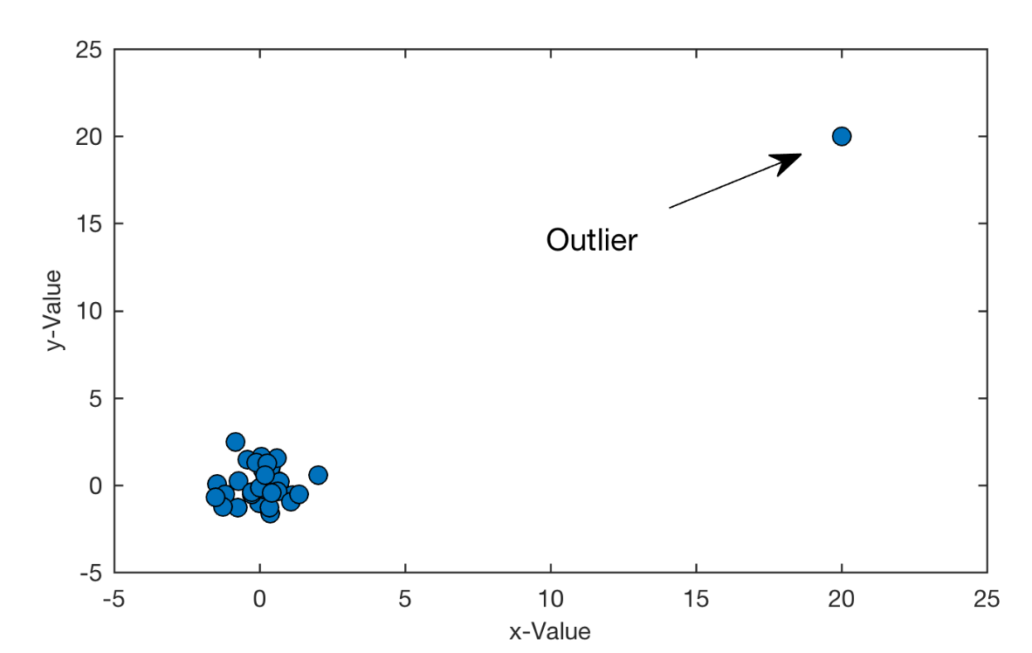
Step 2.1: Outlier Removal
Example
I wasn’t sure what an outlier was so I did a little research.
I came to the conclusion that an outlier is a value which is significantly different from other values in a dataset and, therefore, modifies the overall mean, variance and other statistical characterises in the data's overall distribution.
Researching outliers

Slide 11
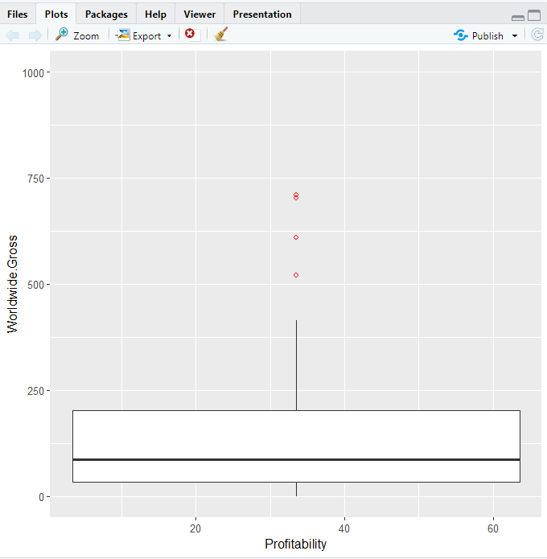

Step 2.1: Outlier Removal
Checking for outliers
I checked for outliers and used a boxplot to highlight each one. I used shape ‘1’ in the colour red.

Slide 12
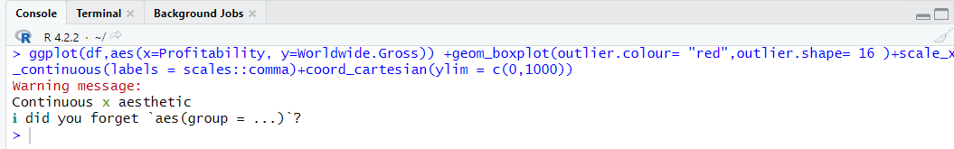
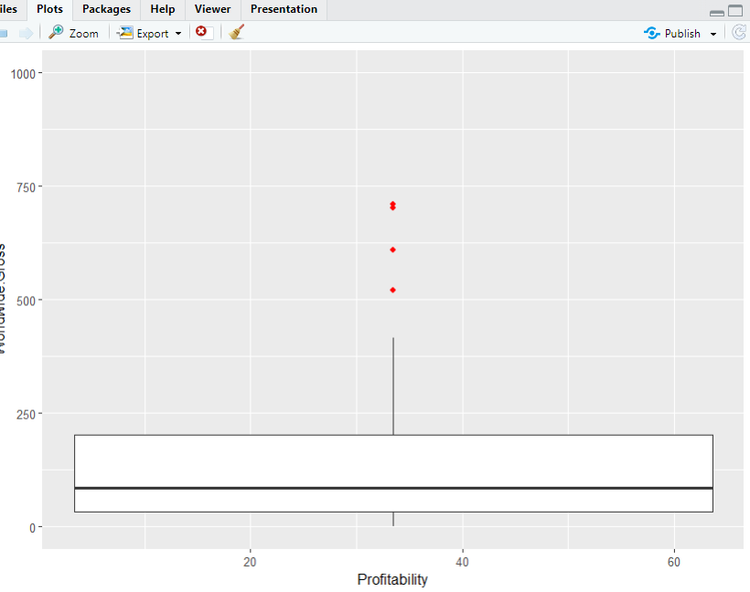
Step 2.1: Outlier Removal
Checking for outliers
I changed my points to shape ‘16’, in red to make them easier to see on my boxplot.

Slide 13
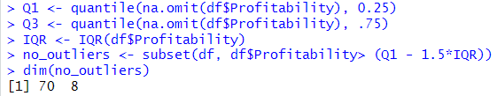
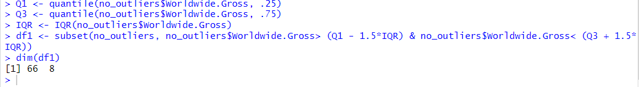
Step 2.1: Outlier Removal
I then proceeded to remove the outliers from ‘Profitability’ and ‘Worldwide.Gross’.
Once the outliers were removed, I again called dim(df) which showed me I was left with 66 observations (rows) and 8 variables (columns).
Removing outliers

Slide 14
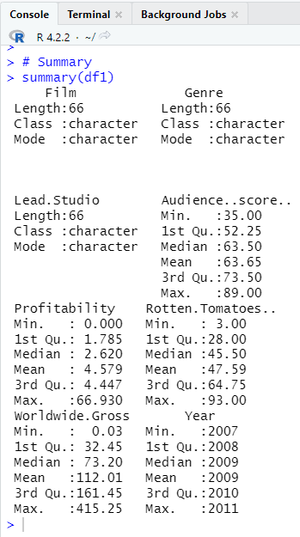
Step 3: Exploratory Data Analysis
I called ‘summary(df1)’ which gave me an overview of the statistics in my data frame.
Film, genre and lead studio all show length, class and mode.
Whereas audience score, profitability, Rotten Tomatoes, worldwide gross and year all show minimum, 1st quartile, median, mean, 3rd quartile and maximum.
Summary Statistics

Slide 15
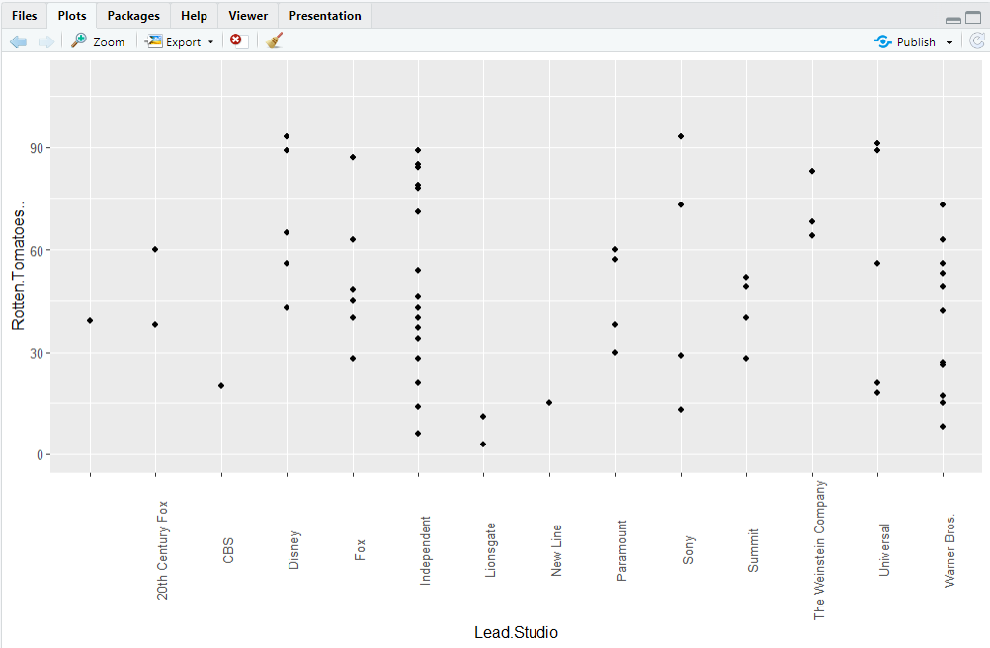
Step 3: Exploratory Data Analysis
Scatterplot
I created a scatterplot that shows the Lead Studios scores on Rotten Tomatoes.

Slide 16
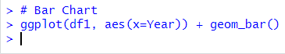
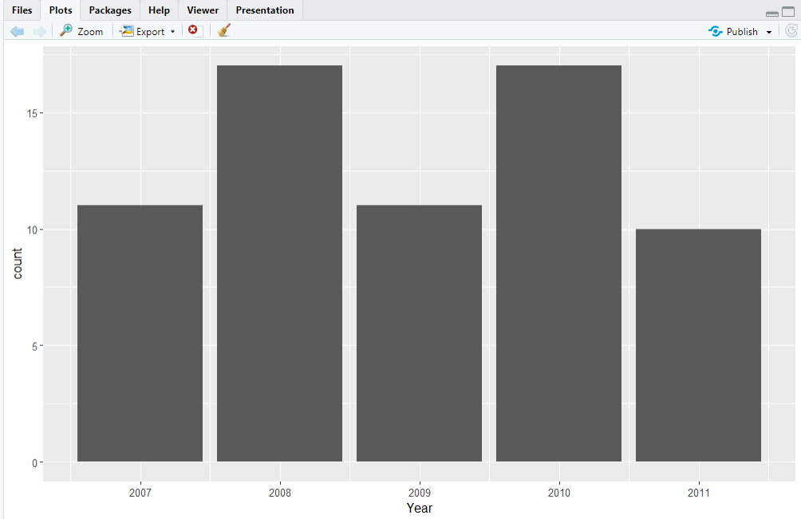
Step 3: Exploratory Data Analysis
Bar Chart 1
I also created a bar chart to show the number of movies in years 2007-2011.

Slide 17
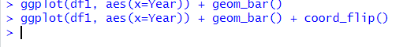
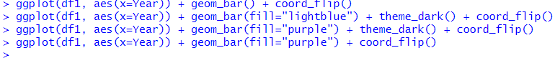
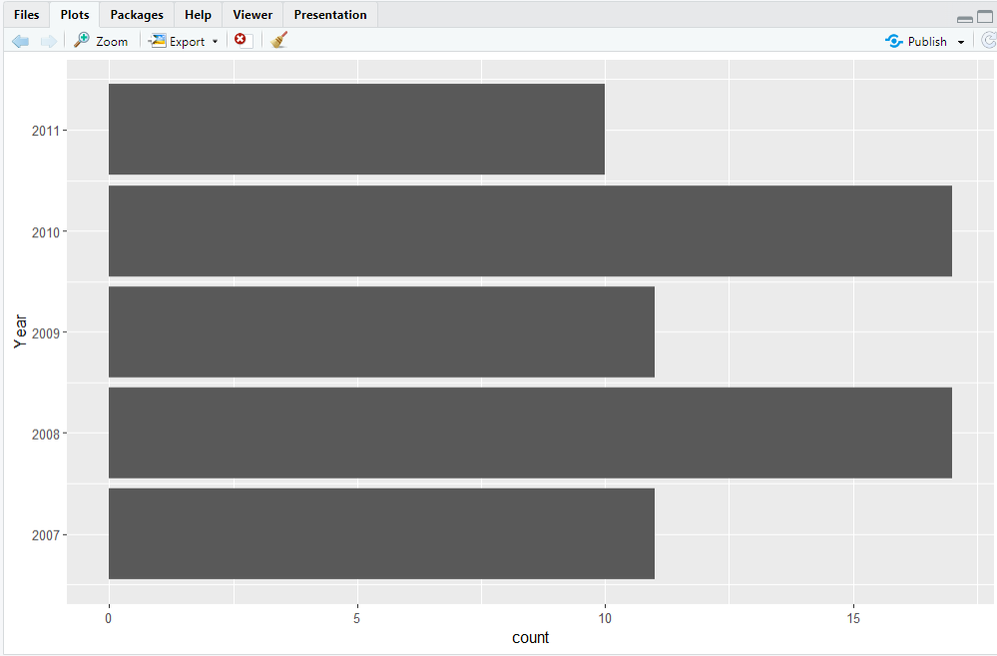
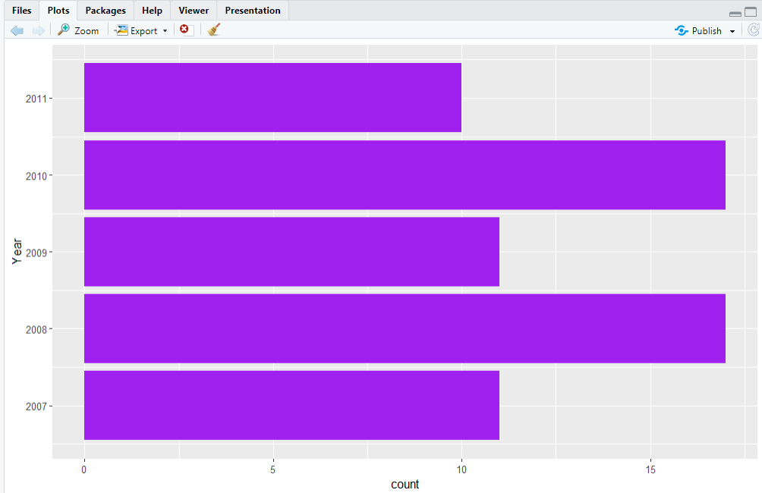
Step 3: Exploratory Data Analysis
Bar Chart 2
I changed the bar chart by making it horizontal and adjusting the colours to make it more eye catching.
I wouldn’t personally use this colour, but it was fun to experiment!

Slide 18
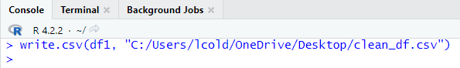
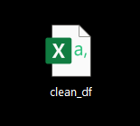
Step 4: Export Data
Finally, I exported my clean data as ‘clean_df.csv’, ready to import in Power BI to create my dashboard.
Exporting

Slide 19
Power BI
Objective: The client would like to see:
The average Rotten Tomatoes ratings of each genre.
The number of movies produced per year.
The audience score for each film.
The profitability per studio.
The worldwide gross per genre.

Slide 20
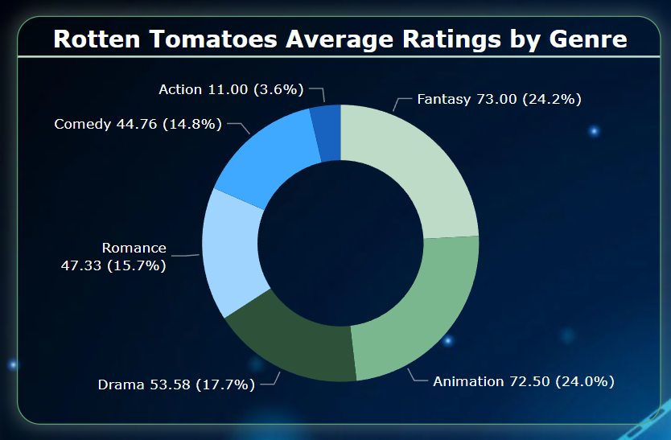
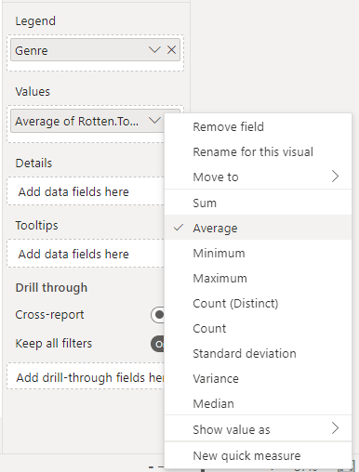
Average
Rotten Tomatoes ratings of each Genre
One I had imported my clean data into Power BI, I created my first visual and changed the Rotten Tomatoes field from sum to ‘Average’.

Slide 21
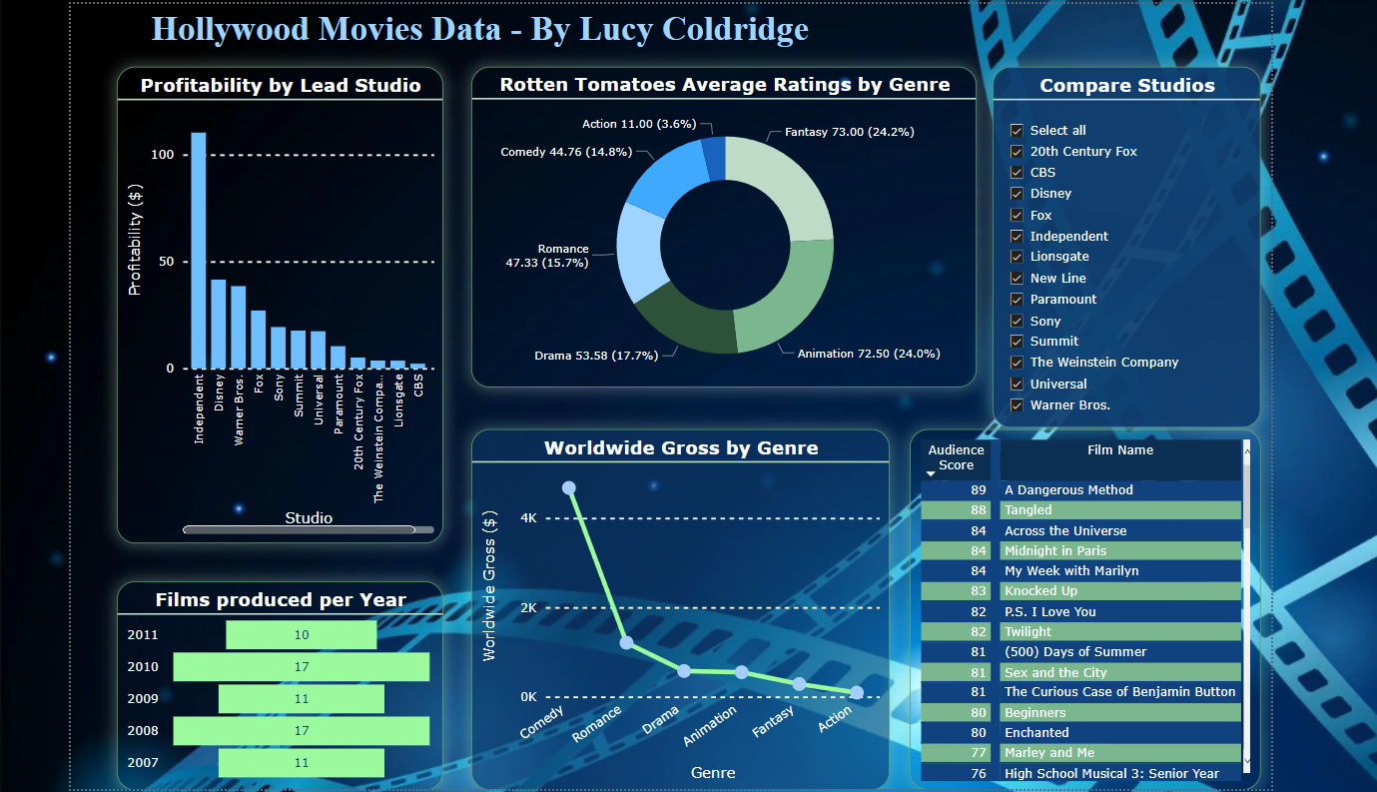
Dashboard
6 Visuals:
Bar Chart
Funnel Chart
Donut Chart
Line Chart
Table
Slicer
Using my data, I created 6 different visuals, all showing information the client asked for. I also used a blue and green colour palette as this is the clients company colours.

Slide 22
